Slide 1
Broadband outage detection
Mohammed Dadapeer
Batch_78_Phd

Slide 2
Problem Description
Here we are deducting the outage duration, And the company has classified into 3
categories like 0, 1 and 2.
0 = No outage.
1 = Few minutes and max for 2 hours.
2 = Outage more than 2 hours and last’s for few days.
And the company has provided 5 Different data sets likely,
Broadband Data
Outage Data
Server Data
Report Data
Train Data
Test Data needs to predict.
Lets Understand above data sets one by one in next slides,

Slide 3
Exploratory data analysis and preprocessing
Broadband Data : There are 10 different types of broadband with 21706 Id’s
Outage Data : There are 5 different types of outage with 18552 Id’s
Server Data : There are 53 transit server type with 31170 Id’s
Report Data : There are 386 log report types with 58761 Id’s
Train Data : There are 3 types of Outage duration with 5904 Id’s and 876 area code
Test Data : There 1477 Id’s with 531 area code, When need to predict outage duration?

Slide 4
Feature Engineering
first merged train and test data and given specific name has data and added a extra column like
Yes and No.
Merging the data sets by one by one with Train and test data, and converting row into columns.
Sorted data by Id and adding Id as the variable in model.
Creating log report of the outage in previous instance.
Creating patterns of log report, i.e. the ones which are present or not present In particular a row.
Sequences of outage type, i.e. the kind of outage type which occurred in the last 5 instance.

Slide 5
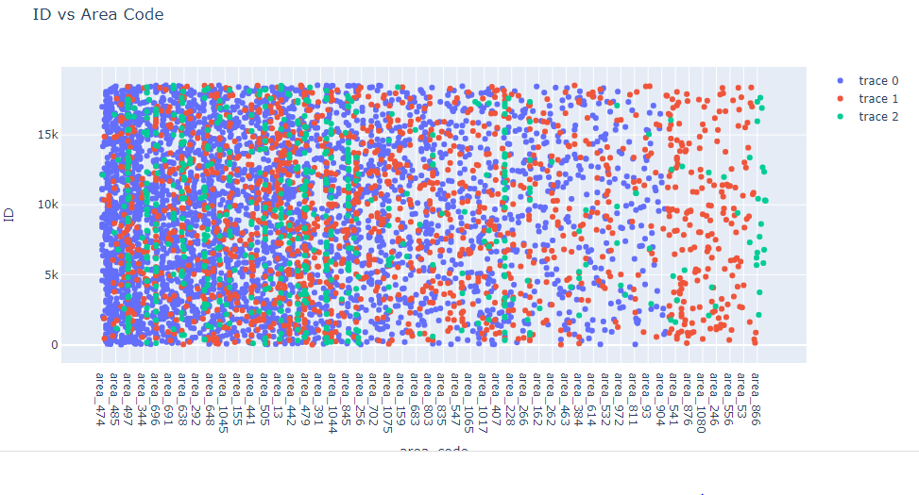
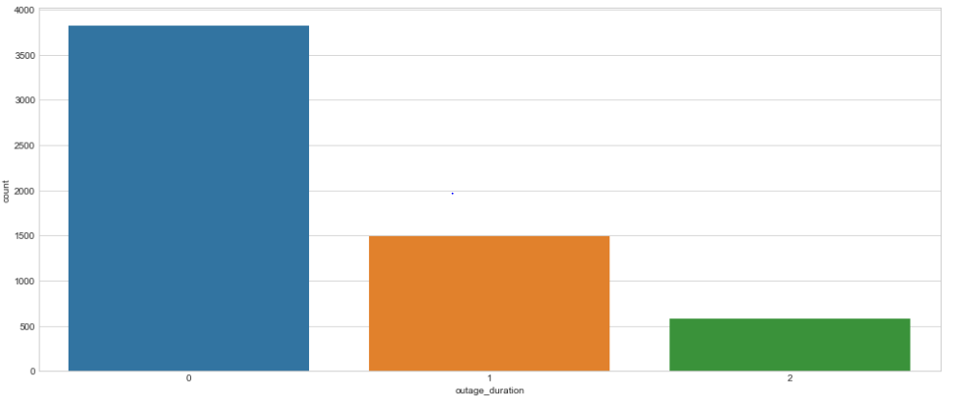
Visualization : Train data
From the plot we can see the max outage duration
0 is 65% (3827)
1 is 25% (1496)
2 is 10%( 581)

Slide 6
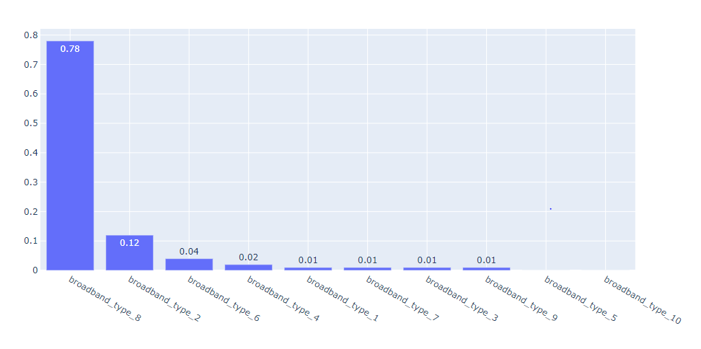
Most outage duration in broadband type
Below plot shows that broadband type 8 i.e. ADSL-1 is more susceptible to long outage duration
X axis : broadband type, Y axis : percentage of volume

Slide 7
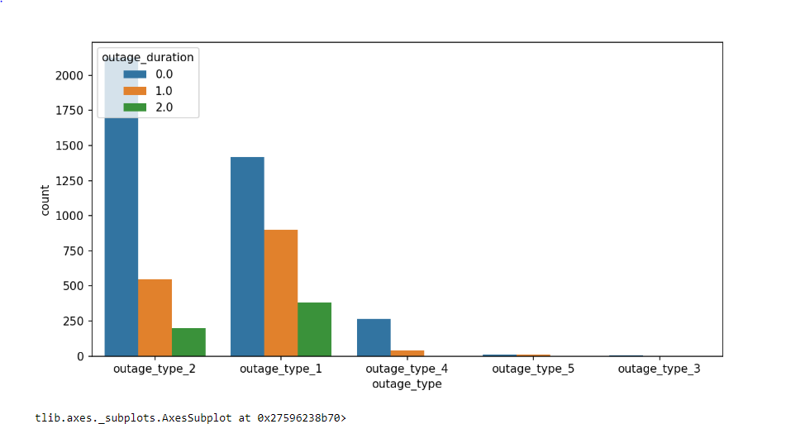
Most outage duration in outage type
Below plot shows how each outage type has contributed to outage duration, also we can infer that
Outage type 1 and 2 are contributing more to long outage duration.

Slide 8
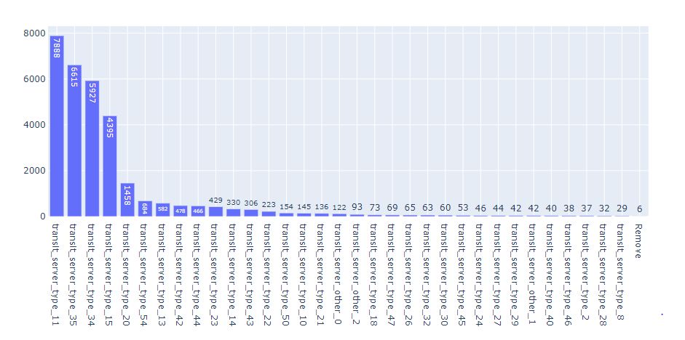
Most outage duration in server type
Below plot shows the most outage duration server type is 11, 35,34 and 15.
X axis : Transit server type, Y axis : Id’s

Slide 9
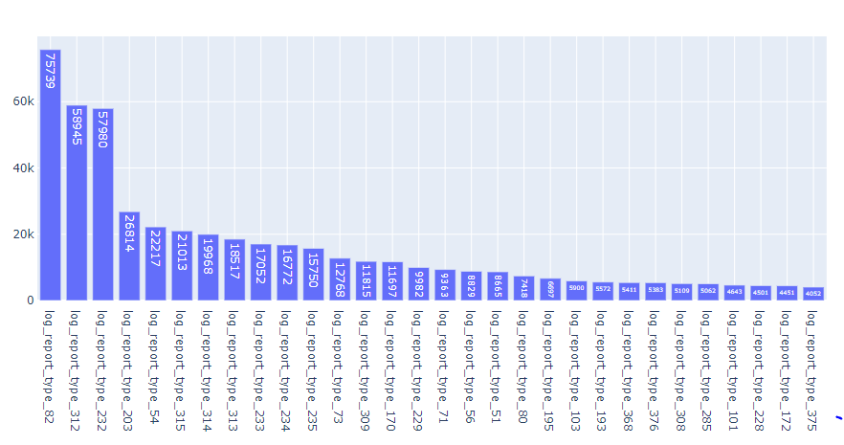
Most outage duration report type based on volume
Below is the plot for top 30 log report type based on volume.
X axis : log report type, Y axis : sum of volume.

Slide 10
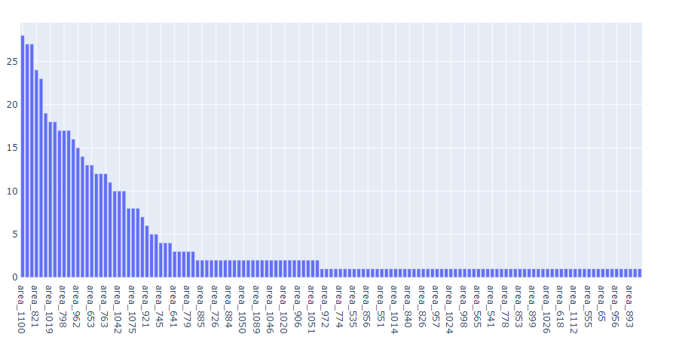
Most outage duration area codes
Below plot shows the most outage duration area.
X axis : area code, Y axis : most outage duration.

Slide 11
Model building
Model 1 : Navie bayes
Model 2 : Decision tree
Model 3 : Grid search CV
Model 4 : Random Forest
Model’s | Accuracy Train \ Test | Precision Train \ Test | Recall Train \ Test | F1 Score Train \ Test
Navie Bayes | 0.80 \ 0.74 | 0.76 \ 0.67 | 0.77 \ 0.69 | 0.76 \ 0.67
Decision Tree | 1.0 \ 0.67 | 1.0 \ 0.59 | 1.0 \ 0.60 | 1.0 \ 0.59
Grid Search cv | 0.80 \ 0.74 | 0.76 \ 0.67 | 0.77 \ 0.69 | 0.76 \ 0.67
Random Forest | 1.0 \ 0.75 | 1.0 \ 0.69 | 1.0 \ 0.69 | 1.0 \ 0.69

Slide 12
Answers for operation team
Which areas are most prone to long outage durations?
Answer : Area 1100 is most prone to long outage duration.
And the top 5 areas most prone to outage area.
area_1100 = 28
area_1107 = 27
area_600 = 27
area_ 821 = 24
area_734 = 23
2. Which broadband types are suspect of long outage durations? Answer: broadband type 8 i.e. ADSL-1 is more susceptible to long outage duration
And the top 5 broadband outage duration
Broadband_type_8- ADSL 1: number of outages = 544
Broadband_type_2- ADSL 2: number of outages = 82
Broadband_type_6- ADSL 2+: number of outages = 26
Broadband_type_4- Fiber1 : number of outages = 17
Broadband_type_1- Fiber Ultra: number of outages = 10

Slide 13
3. Any other recommendations to improve the detection of outage durations?
Answer : Detecting the outage durations by looking at the report data the columns
log report type, of 386 different levels Generated by the customers.
Answer : By using the transit server type which has 53 types of server, looking at the types
of server we can detect the Outage duration.
Conclusion :
After working with the data set, the model Prediction was only 0.67 score as the given was not
sufficient for the prediction of the model.
As there were 18552 unique ID and combining train and test we ended up with 7381 ID, where
we had to drop the rest ID and features.
Grid Search cv gave the better result after Decision tree.

Slide 14
Thank you

